Slide 1
CSS
COLORS
CSS supports over 140 color names.
CSS Colors are specified using predefined color names, or RGB, HEX, HSL, RGBA, HSLA values.
In CSS, a color can be specified by using a predefined color name:
<h1 style="color: red;">Hello World</h1>
You can set the color of borders:
<h1 style="border: 2px solid red;">Hello World</h1>

Slide 2
CSS Colors
Colors in CSS can be specified by the following methods:
Hexadecimal colors
Hexadecimal colors with transparency
RGB colors
RGBA colors
HSL colors
HSLA colors
Predefined/Cross-browser color names
With the currentcolor keyword

Slide 3
USE CASE
BACKGROUND COLOR
You can set the background color for HTML elements:
Example:
<h1 style="background-color: darkgreen;"> BACKGROUND COLOR </h1>
You can set the color of text:
Example:
TEXT COLOR
<h1 style="color: red;"> TEXT COLOR </h1>

Slide 4
COLOR VALUES
Remember that the default font color is Black
In CSS, colors can also be specified using RGB values, HEX values (and others such as HSL, HSLA etc)
Example:
Same as color name "Tomato":
rgb(255, 99, 71)
#ff6347
<h1 style="background-color:rgb(255, 99, 71);">...</h1>
<h1 style="background-color:#ff6347;">...</h1>
<h1 style="background-color:rgb(255, 99, 71,0.5);">...</h1>

Slide 5
CSS RGB COLORS
An RGB color value represents RED, GREEN, and BLUE light sources.
rgb(red, green, blue)
Each parameter (red, green, and blue) defines the intensity of the color between 0 and 255.
For example, rgb(255, 0, 0) is displayed as red, because red is set to its highest value (255) and the others are set to 0.
All the color parameters set to 0 will display black, like this: rgb(0, 0, 0) = black.
All the color parameters set to 255 will display White, like this: rgb(255, 255, 255) = white.

Slide 6
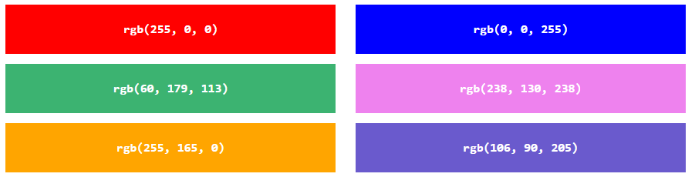
SOME RGB COLORS MIX

Slide 7
RGBA : The alpha value
rgba(red, green, blue, alpha)
The alpha parameter is a number between 0.0 (fully transparent) and 1.0 (not transparent at all):
RGBA color values are an extension of RGB color values with an alpha channel - which specifies the opacity for a color
An rgba(0, 0, 0, 0.2) will give you the color black which turns out to be transparent because the alpha value is set at 0.2 which is very transparent.

Slide 8
CSS HEX COLORS
In CSS, a color can be specified using a hexadecimal value in the form: #rrggbb or #rgb (if each of rgb are the same). It is called hexadecimal as it uses 6 decimal numbers to denote the color codes.
Where rr (red), gg (green) and bb (blue) are hexadecimal values between 00 and ff (same as decimal 0-255).
For example, #ff0000 is displayed as red, because red is set to its highest value (ff) and the others are set to the lowest value (00).
To display black, set all values to 00, like this: #000000.
To display white, set all values to ff, like this: #ffffff.
Use the 3 digit HEX if all the values of the color code are same. Eg, #ff00cc will be #f0c. #bb5588 with be #b58. #ff99aa will be #f9a. E.t.c.

Slide 9
CSS HSL COLORS : Hue, Saturation, & Lightness
The Hue color wheel is from 0 to 360. 0 is red, 120 is green and 240 is blue.
The Saturation is the intensity of the color, it is in percentage value. Saturation 0% is completely gray while 100% means full or pure color, while 50% means gray but you can still see the color
The Lightness is also in percentage, means how much light you want to give to the color. 0% is black and 100% is white. 50% is neither black or white
THE HSLA
The HSL also have a alpha value which denote the level of transparency. Ranges from 0.0 (full transparency) to 1.0 (not transparent)

Slide 10
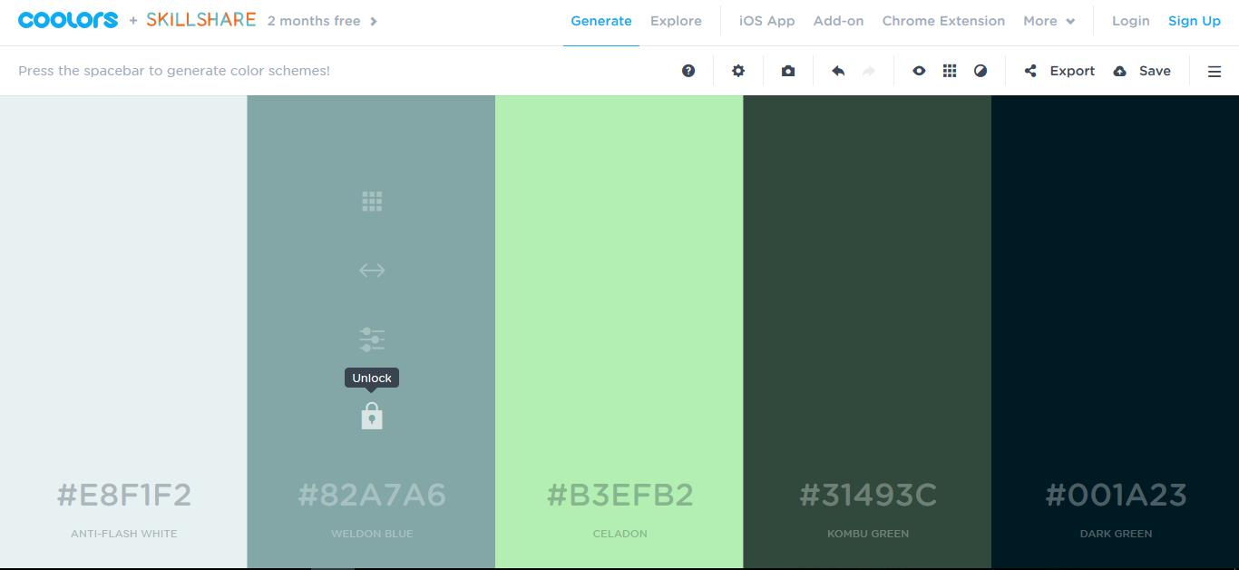
Getting colour combination from coolors.co & colorhunt.co

Slide 11
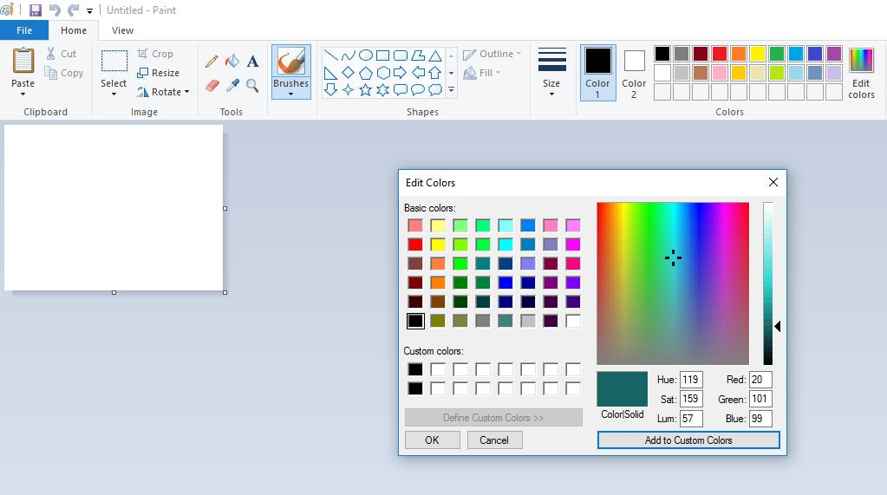
MS Paint Tool

Slide 12
CSS BACKGROUND PROPERTIES & BOX MODEL (border, margin and padding)

Slide 13
Styling Your Page Background
The background of your webpage is the part underneath the webpage contents area*
The CSS background properties are used to define the background effects.
background-color: Sets a solid color for the background.
background-image: Specifies a background image to appear in the background of the element.

Slide 14
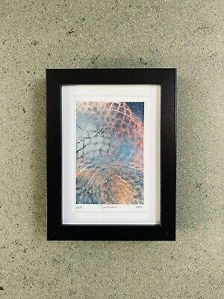
Background Image vs. Image
<---------------------- Background Image
<---------------------------------Image
With background-image, other elements can sit on the background
An image (img) can even sit on the background!

Slide 15
Background Properties
background-position: Specifies the position that the background should appear inside the element background.
background-size: Specifies the dimension of the background image within the container cover / contain / width and height
background-repeat: Specifies whether the background should be repeated (tiled) or not. Can be applied to repeat tiled background
background-attachment: Specifies the behavior of an element's background when its content scrolls. (Scroll with content or fixed?)

Slide 16
Background-color
The background-color property specifies the background color of an element. Note that you can use any of the named, rgb, rgba, hex, hsl color methods to specify a background-color.
    div {
    background-color: blue;
    opacity: 0.2;
    }
    Syntax:
background-color: color|transparent.
Background color can also have the transparent value which makes the element have no pre-defined color. We can make the default white background of the input field to take on another color (maybe our set background-color), by setting the input field background property to transparent. input {background: transparent;}

Slide 17
Background-image
The background-image property specifies an image to use as the background of an element. By default, the background-image is placed at the top-left corner of an element and repeated both vertically horizontally.
NOTE: Always set a background color as a fallback incase the background-image becomes unavailable for some reasons.
Example:
    body {
    background-image: url("paper.gif");
    }
Note: When using a background image, use an image that does not disturb the text.

Slide 18
Background-repeat
By default, the background-image property repeats an image both horizontally and vertically. Some images should be repeated only horizontally or vertically, or they will look strange:
Example:
body {
background-image: url(“alumni.png");
background-repeat: repeat-x; OR background-repeat: repeat-y;
}
Tip: To repeat an image vertically, set background-repeat: repeat-y;
Also, background image can only be shown once.
background-image: url(“alumni.png");
background-repeat: no-repeat;

Slide 19
Background-position
The background-position property of an image specifies where the image will be positioned in our webpage.
Background-position: top | bottom | center (optionally combined with left | right)
Example:
body {
background-image: url("img_tree.png");
background-repeat: no-repeat;
background-position: right top;
}

Slide 20
Background-attachment
The background-attachment property specifies whether the background image should be fixed or scroll (i.e. will not scroll with the rest of the page)
Example:
body {
background-image: url("img_tree.png");
background-repeat: no-repeat;
background-position: right top;
background-attachment: fixed;
}
Syntax:
background-attachment: scroll|fixed

Slide 21
Background-size
The background-size property specifies the size of the background image. This can be set using pixel. Width first 700px and height 500px.
Example:
          body {
          background-image: url("img_tree.png");
          background-repeat: no-repeat;
          background-attachment: fixed;
          background-size: 700px 500px;
          }
Other background-size values are: background-size: auto | cover | contain | width height
The cover value tells the browser to cover the whole area of an element while the contain tell the browser to show the whole image. The auto tells the browser to calculate the size based on the actual size of the image. It fits automatically.

Slide 22
Background Shorthand
background-color
background-image
background-position
Background-size
background-repeat
background-attachment
  body{
  background: #ff0000 url(“cars.png") right top cover no-repeat fixed;
  }
Note that it doesn’t matter if any one of the values above is missing, so far the order of arrangement is maintained.
Note that this order must be followed when using the background properties shorthand

Slide 23
CSS BOX MODEL (border, margin and padding)

Slide 24

BOX MODEL
The model describes the space of the content taken by an element. An element can be considered as a box. It is represented by a box and each box has four edges
The CSS box model is essentially a box that wraps around every HTML element. It consists of: content, padding, borders and margins. The image below illustrates the box model:

Slide 25
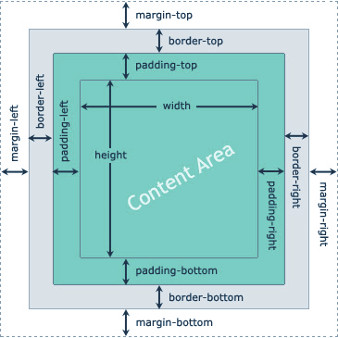
The content of the box are the texts and images which appears in our browser.
The border is what wrap our content and by default, it is invisible until we apply color to make it visible.
The padding is the area inside the box, between the content and the border.
The margin is the area outside the box between the border and other surrounding elements.

Slide 26
Border Properties
The CSS border property allow you to set the width, style, and color of an element border.
border-width: This specify the width of all four corners of the element border. It can be set as:- thin, medium, thick, pixel(px).
SPECIFIC SIDE BORDER-WIDTHS
Th border-width can also be set to specific side, and it goes in a clockwise direction. Top-right-bottom-left. E.g., p{border-width: 30px 20px 15px 5px;} OR div{border-width: 20px 10px}
border-color: This specify the colors of all four sides of the element border. It can be set as:- named colors, rgb, Hex, HSL.
SPECIFIC SIDE BORDER-COLORS
Th border-width can also be set to specific side, and it goes in a clockwise direction. Top-right-bottom-left. E.g., p{border-color: red green blue yellow;}

Slide 27
border-style: This specify the styles of all four sides of the element border. It can be set as:- dotted, solid, dashed, and double, inset, outset, groove, ridge. div{border-style: double; or none; or solid;}
SPECIFIC SIDE BORDER-STYLE
Th border-style property is used to set specific side, and it is written as:- border-bottom-style, border-left-style, border-right-style, e.t.c. E.g., p{border-top-style:dashed;} OR div{border-bottom-style: groove}
ROUNDED BORDER
border-radius: used in creating rounded borders. Can be specified in px or %, eg 5px . To create a complete round box, the element must have equal width and height, border-radius must be 50%
Note that you can also be able to control each corner of the border using % or pixels:
  border-radius: 50% 0 50px 10%;

Slide 28
Border Shorthand
We can specify border using the CSS border property. This property needs three values to display border properly. They are: The width (px) of the border, style (solid, dashed, dotted, double) of the border and the color of the border.
All elements have some imaginary border ; specifying the border style allows you to make the imaginary border “Real” hence the most important property is the style. If you omit it, colors , width etc won’t work – you would be trying to color an invisible border!

Slide 29

EXERCISE – 10 mins
Objectives:
  Understand how to use the border properties especially the border-radius.
  Demonstrate the use of id and class, background color property
Achieve as close as possible. The picture shown is an image hence output may not exactly look like this

Slide 30
PADDING
Recall that this is the area between the content and the border.
We can also apply a different amount of padding on different sides using the padding-top, padding-right, padding-bottom, padding-left properties.
The shorthand padding property combines for all sides as .box{padding: 100px 150px 100px 80px;} representing top, right, bottom, left
A missing value makes use of the adjacent value. Example: padding:100px 50px uses 100px for the top and bottom, while it uses 50px for the right and left. However, if we have three values, the middle value will be set for left and right.

Slide 31
Padding and Element Width
The CSS width property specifies the width of the element's content area. The content area is the portion inside the padding, border, and margin of an element (the box model).
So, if an element has a specified width, the padding added to that element will be added to the total width of the element. Example, if you set the width of an element at 300px and padding at 25px, the actual width of that element will be 350px because the padding will add 25px to the right and left sides of the element box.
However, you can use the box-sizing property set to border-box to keep the width at 300px. This make the element to maintain its actual width; if padding is increased, the available content space will decrease.

Slide 32
Example
Here, the <div> element is given a width of 300px. However, the actual width of the <div> element will be 350px (300px + 25px of left padding + 25px of right padding):
div {
width: 300px;
padding: 25px;
background-color: red;
}
Use the box-sizing property to keep the width at 300px, no matter the amount of padding:
div {
width: 300px;
padding: 25px;
background-color: red;
box-sizing: border-box;
}

Slide 33
MARGIN
Recall that the Margin is the area between the border and the other surrounding elements.
We can also apply a different amount of margin on different sides using the margin-top, margin-right, margin-bottom, and margin-left properties.
The shorthand margin property combines for all sides as .box{margin: 100px 150px 100px 80px;} representing top, right, bottom, left
A missing value makes use of the adjacent value. Example: margin:100px 50px uses 100px for the top and bottom, while it uses 50px for the right and left. However, if we have three values, the middle value will be set for left and right.

Slide 34
Margin auto and inherit value
Inherit:
This allows the child element of the div, say <p> to inherit the margin value of the parent, say <div> .
Example:
div {
border: 1px solid red;
margin-left: 100px;
}
div p {
margin-left: inherit;
}
Auto:
You can set the margin property to auto to horizontally center the element within its container. The element will then take up the specified width, and the remaining space will be split equally between the left and right margins.
Example
div {
width: 300px;
margin: auto;
border: 1px solid red;
}

Slide 35
More on Width: Tips for calculating width
When you set the width and height properties of an element with CSS, you just set the width and height of the content area.
To calculate the full size of an element, you must also add padding, borders, and margins.
The total width of an element should be calculated like this:
Total element width = width + left padding + right padding + left border + right border
Assume we want to style a <div> element to have a total width of 350px:
Here is the calculation: 320px (width) + 20px (left + right padding) + 10px (left + right border)
+ 0px (left + right margin) = 350px
Total element height = height + top padding + bottom padding + top border + bottom border

Slide 36
Min-height, min-width & max-height, max-width
Min-height can be used to specify the minimum height of an element content box. Starting height of an element. It will be applied when the content is smaller than the minimum height; otherwise, if the content is larger, this property has no effect. Values are min-height: none | length | initial | inherit;
It sets the maximum height of the element's content box. It means that the height of the content box can be smaller than the max-height value, but cannot be greater. It sets the upper bound on the element's height. When the content is larger than the maximum height, it will overflow. If the content is smaller than the max-height, this property does not affect it. Values are max-height: none | length | initial | inherit;
It is used to set the minimum width of the element's content box. It means that the width of the content box can be greater than the min-width value, but cannot be shorter. It sets the lower bound on the element's width. It will be applied when the content is smaller than the minimum width; otherwise, if the content is larger, this property has no effect. Values are min-width: none | length | initial | inherit;
Max-width set the maximum width of the element's content box. It means that the width of the content box can be smaller than the max-width value, but cannot be greater. It sets the upper bound on the element's width. When the content is larger than the maximum width, then it will automatically change the height of the element. If the content is smaller than the max-width, this property has no effect. Values are max-width: none | length | initial | inherit;

Slide 37
The CSS Display Property
The display property is the most important CSS property for controlling layout. The display property can be used to specify how the browser renders an element; it can be used to convert an inline element to a block level and vice versa.
The display property is used to change the default display behavior of HTML elements.
To convert an inline element like span to a block-level element, use display: block
To convert a block element like <p> to an inline element, use display: inline
Recall that inline elements DO NOT respond to width and height, there is a 3rd value of display that allows you to specify width and height on inline elements.
display: inline-block;

Slide 38
Other Display Properties
Inline-block makes the element behave like a typical inline element in terms of just occupying the space it needs but will respond to width and height.
We can leverage this property to create an appropriate navigation bar
Flex: Displays an element as a block-level flex container
Grid: Displays an element as a block-level grid container
Display: none; The display: none; is commonly used with JavaScript to hide and show elements without deleting and recreating them. We also have visibility: hidden;

Slide 39
The Display Property: For creating a navigation bar
By convention, navigations are usually placed within a <ul>…</ul> tag.
    <ul>
      <li> <a href=“”>Home</a></li>
      <li> <a href=“”>About Us</a></li>
      <li> <a href=“”>Contact Us</a></li>
    </ul>
Since <li> is a block level element, we can use the display: inline-block; property to make each of them turn to horizontal menu bar.

